Slide 1
Off-policy Learning with Recognizers (Precup et al. 2005)
Zhuoyu Wang
COMP 767
Feb 3, 2017

Slide 2
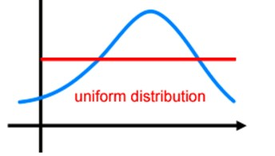
Importance sampling
The problem is to find E _{π}(z(a)).
π(a)
b(a)
a

Slide 3


Importance sampling
The problem is to find E _{π}(z(a)).
$$E_{π}\left(z\left(a\right)\right)=\int{z\left(a\right)π\left(a\right)da}=\int{\frac{z\left(a\right)π\left(a\right)}{b\left(a\right)}b\left(a\right)da}=E_{b}\left(\frac{z\left(a\right)π\left(a\right)}{b\left(a\right)}\right)=E_{b}\left(z\left(a\right)\frac{π\left(a\right)}{b\left(a\right)}\right)$$
π(a)
b(a)
$\frac{π\left(a\right)}{b\left(a\right)}$: Likelihood ratio or correction
a

Slide 4
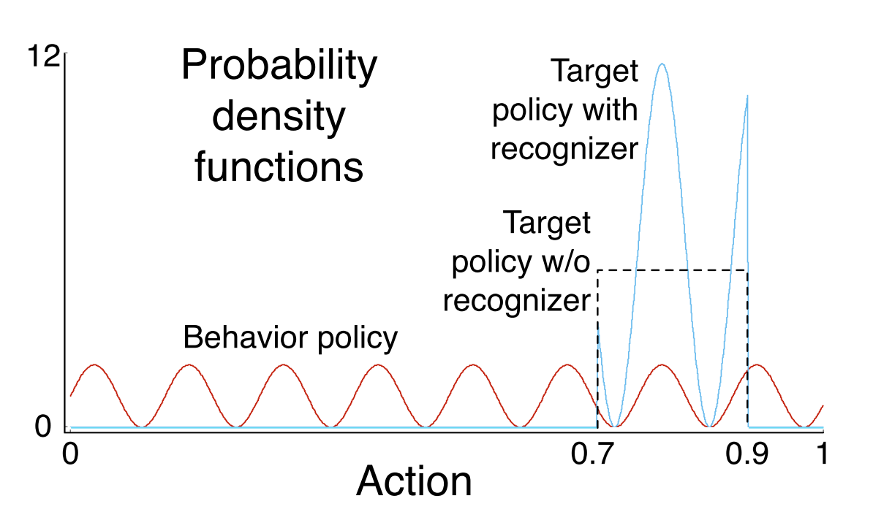
Recognizer
A special kind of importance sampling.
π(a)
b(a)
a
Outcome: z(a)
From Off-policy Learning with RecognizersPrecup et al. 2005

Slide 5

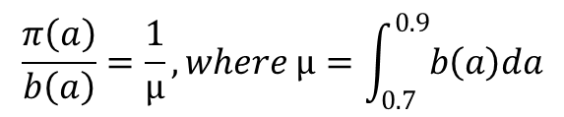
Recognizer
A special kind of importance sampling.
π(a)
$$E_{π}\left(z\left(a\right)\right)=\int{z\left(a\right)π\left(a\right)da}=\int{\frac{z\left(a\right)π\left(a\right)}{b\left(a\right)}b\left(a\right)da}=E_{b}\left(\frac{z\left(a\right)π\left(a\right)}{b\left(a\right)}\right)=E_{b}\left(z\left(a\right)\frac{π\left(a\right)}{b\left(a\right)}\right)$$
b(a)
a
Outcome: z(a)
$$\frac{π\left(a\right)}{b\left(a\right)}=\frac{1}{μ}, where μ=\int_{0.7}^{0.9}{b\left(a\right)da}$$
From Off-policy Learning with RecognizersPrecup et al. 2005

Slide 6


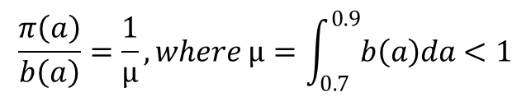
Recognizer
A special kind of importance sampling.
π(a)
$$E_{π}\left(z\left(a\right)\right)=\int{z\left(a\right)π\left(a\right)da}=\int{\frac{z\left(a\right)π\left(a\right)}{b\left(a\right)}b\left(a\right)da}=E_{b}\left(\frac{z\left(a\right)π\left(a\right)}{b\left(a\right)}\right)=E_{b}\left(z\left(a\right)\frac{π\left(a\right)}{b\left(a\right)}\right)=\frac{1}{μ}E_{b}\left(z\left(a\right)\right)$$
b(a)
a
Outcome: z(a)
where 0.7$≤a≤0.9$
$$\frac{π\left(a\right)}{b\left(a\right)}=\frac{1}{μ}, where μ=\int_{0.7}^{0.9}{b\left(a\right)da}<1$$
From Off-policy Learning with RecognizersPrecup et al. 2005

Slide 7
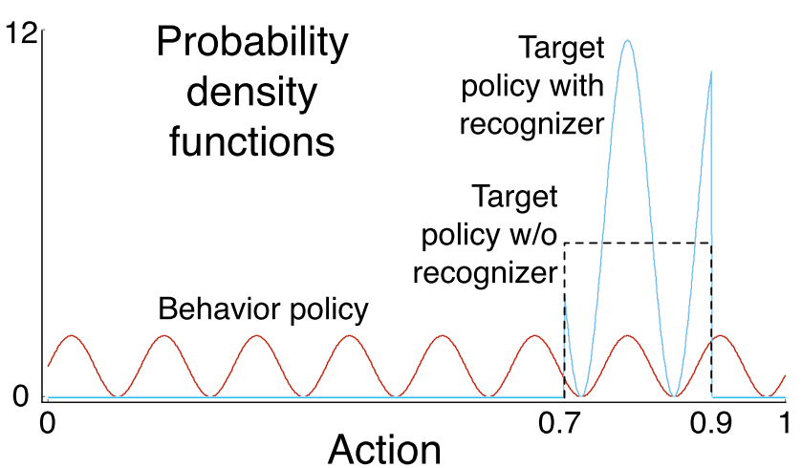

Theorem 1
Roughly speaking: For all possible $g\left(a\right)=\frac{π\left(a\right)}{b\left(a\right)}$, the recognizer has the smallest Var($\frac{π\left(a\right)}{b\left(a\right)}$).
The proof (see the paper)
The message:
When $\frac{π\left(a\right)}{b\left(a\right)}$ is a constant, it has the smallest variance.

Slide 8
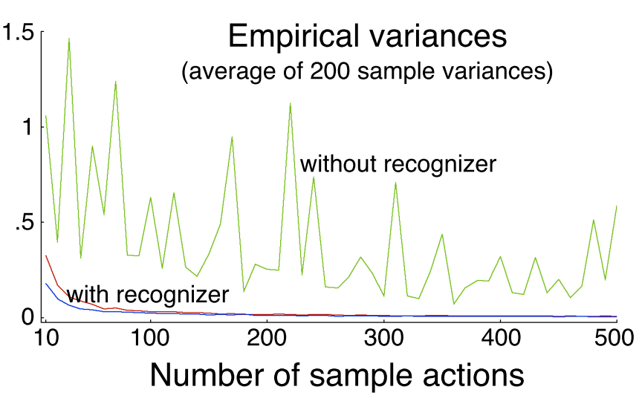
Variance
Why it works?

Slide 9
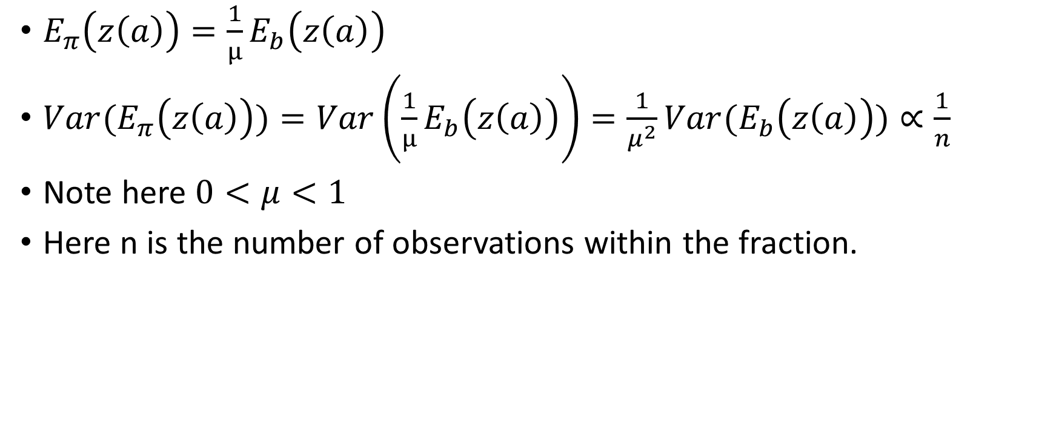
Variance
$E_{π}\left(z\left(a\right)\right)=\frac{1}{μ}E_{b}\left(z\left(a\right)\right)$
${Var(E}_{π}\left(z\left(a\right)\right))=Var\left(\frac{1}{μ}E_{b}\left(z\left(a\right)\right)\right)=\frac{1}{μ^{2}}Var(E_{b}\left(z\left(a\right)\right))∝\frac{1}{n}$
Note here $0<μ<1$
Here n is the number of observations within the fraction.

Slide 10
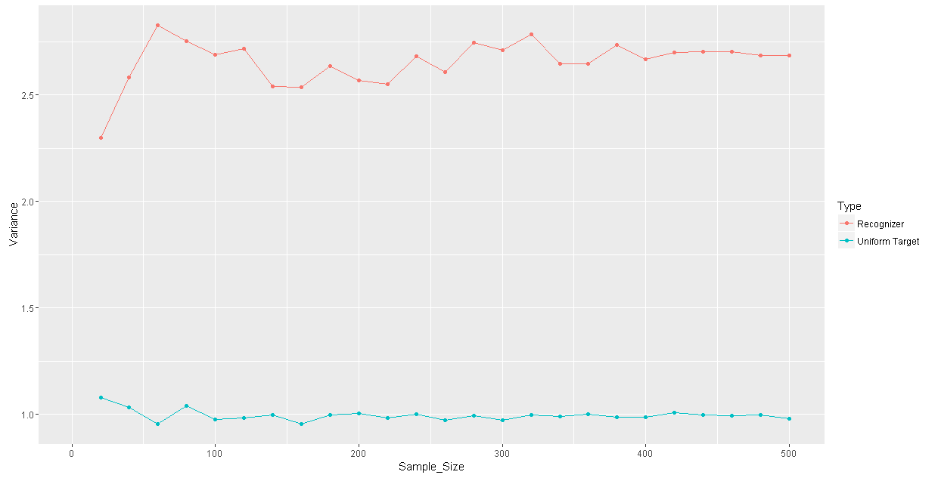
Illustration

Slide 11
Thank you！

